Slide 1

Everyone is talking about DevOps
Simon Aronsson
Founder, Arctic Bit

Slide 2

Simon Aronsson
Software Development Consultant
Agile and DevOps Aficionado
Gopher
@0x12b
simskij
simme@arcticbit.se

Slide 4
DevOps is not about technology

Slide 5

FLOW

Slide 6
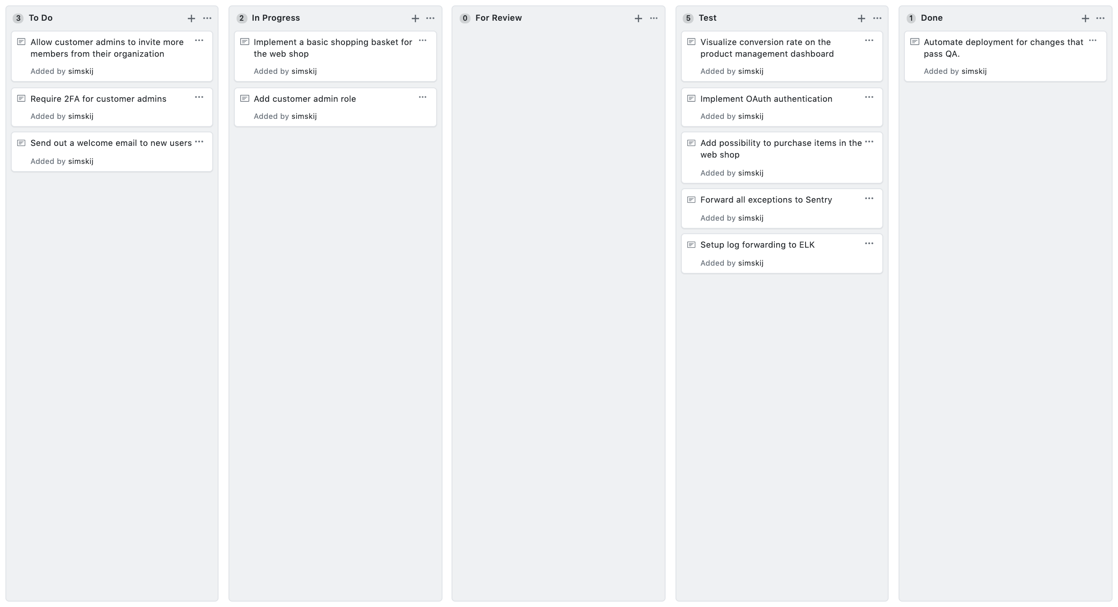

Slide 8
“For any resource that is not a bottleneck, the level of activity from which the system is able to profit is not determined by its individual potential but by some other constraint within the system”
- Eliyahu M. Goldratt The Goal

Slide 9
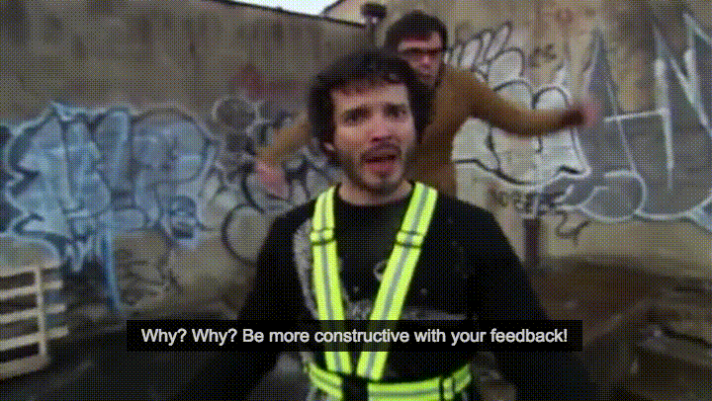
FEEDBACK

Slide 11
Requirements
Design
Code
Test
Acceptance
Production
Maintenance

Slide 15



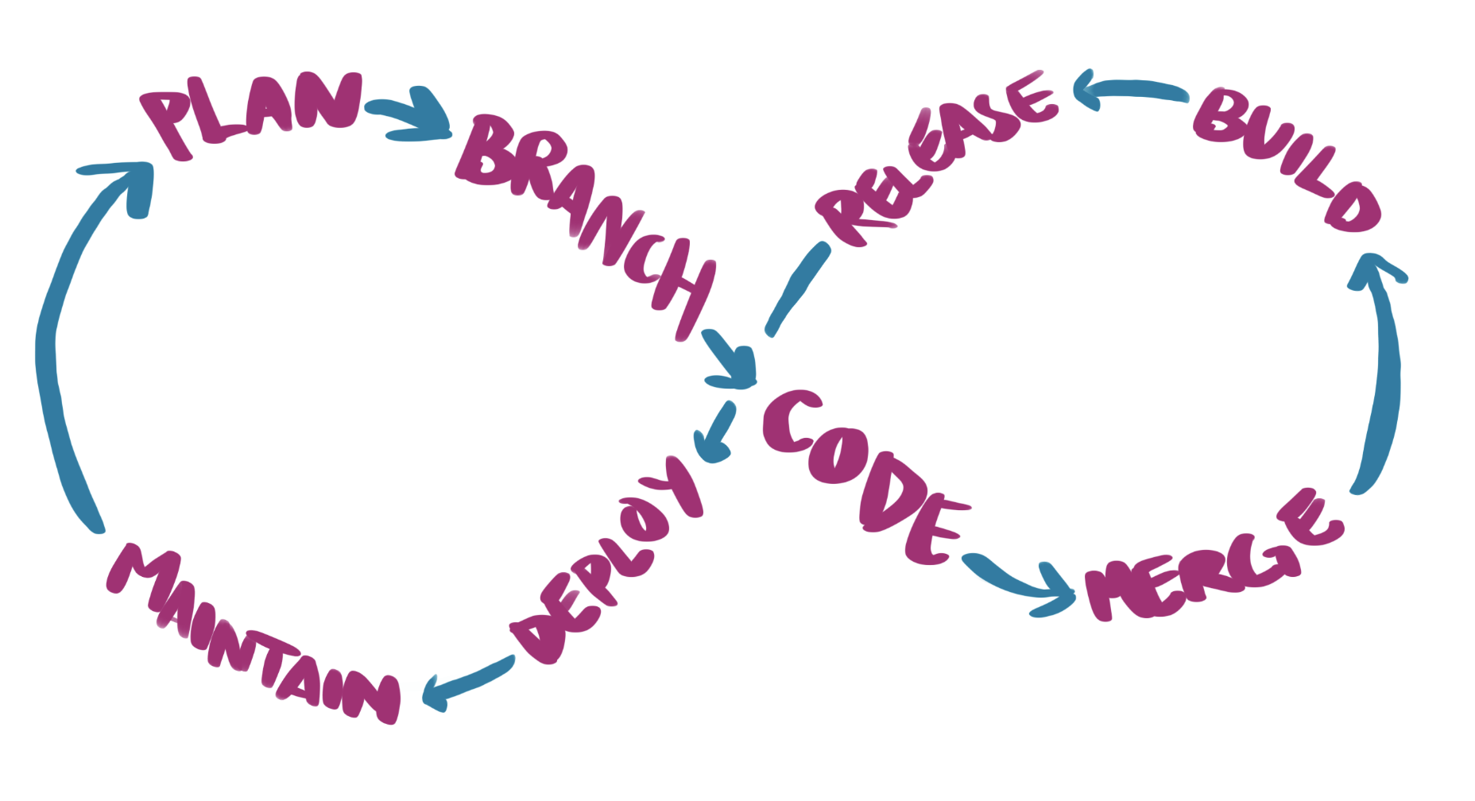




Slide 16

CONTINUOUS LEARNING AND EXPERIMENTATION

Slide 18


Slide 19
How do we encourage collaboration, transparency and trust?

Slide 20
Simon Aronsson
Founder, Arctic Bit

Slide 21
The Business
Development
Operations
Measured on innovation Velocity over stability
Measured on availability Stability over velocity
Needs both

Slide 22
1. Agree on success

Slide 23
2. Be liberal with appreciation

Slide 24
3. Focus on the way forward

Slide 25
4. Blend the teams

Slide 26
“Individuals and interactions over processes and tools
Working software over comprehensive documentation
Customer collaboration over contract negotiation
Responding to change over following a plan”

Slide 27
Embrace the boring

Slide 28
Mob Programming

Slide 29
Open Space

Slide 30
Turn up the good

Slide 31
Thank you for listening!

